Slide 1
DRB January update
An investigation into smallRNA analysis pipeline optmised for both animal and plant samples
1st stage intial target 1: https://github.com/nf-core/smrnaseq
2nd stage from literature: Created interest in mirDeep2 https://github.com/dr-richard-barker/mirDeep2_DRB_exploration
3rd Tangent: Plants miRNA novel detection and quantification not optmised for plants.
4th Recent tangent: smallRNAbench has accuracy benefits and novel mir detection but ultimately failed to run by command line.
Future New target plant tangent: mirkWood vs mirDeep-P2

Slide 2
DRB December update
5 mirDeep2 draft not ready for review from Amanda
→ Feedback from ASGSR experts at ASGSR → MirDeep2 and mirDeep* were recommended
mirDeep* installed → tested with synthetic mir → accuracy test plot → novel mir predictions made
Future work: investigate the TargetScan.jah script use to predict novel mir potential targets.
mirDeep2 installed → tested with synthetic mir → accuracy test plot → novel mir predictions made
Improved fluidity / automation of script.
Future work: mirDeep2 ongoing testing with human data from GLDS-481
miRPlant installed → tested with DRB plant smallRNA → novel mir predictions made
Dicot_specific_miRDeep2 downloaded → plant_specific_setting_under_review → future work test with plant smallRNA samples

Slide 3
Comparison of Small RNA Analysis Tools with Plant & Animal Testing and Internal Open-Source Software
Software | Inputs | Data Products | Comments | Plants | Animals | Open-Source Software | GitHub Link | Research Paper Reference | Types of Small RNA Analyzed | Type of Analysis
sRNAbench | Small RNA-seq reads, reference genome annotation | miRNA expression quantification, novel miRNA prediction, differential expression analysis | Accurate, user-friendly, supports many organisms | ✅ | ✅ | BLAST+, SAMtools, BEDTools, R (optional) | Link | Link | miRNA, piRNA, siRNA | Expression quantification, novel prediction, differential analysis
mirDeep2 | Small RNA-seq reads, reference genome annotation | miRNA expression quantification, novel miRNA prediction, target gene prediction | Good sensitivity, fast processing, supports several organisms | ✅ | ✅ | BLAST, ViennaRNA, miRanda (optional) | Link | Link | miRNA, piRNA | Expression quantification, novel prediction, target prediction
mirDeep-P2 | Small RNA-seq reads, reference genome annotation | miRNA expression quantification, novel miRNA prediction, target gene prediction | Highly accurate, especially for plants, fast processing speed | ✅ | ✅ | BLAST+, ViennaRNA, miRanda, miRBase (optional) | Link | Link | miRNA, siRNA | Expression quantification, novel prediction, target prediction
miRPlant | Small RNA-seq reads, reference genome annotation | miRNA expression quantification, novel miRNA prediction, target gene prediction | Optimized for plant miRNAs, good accuracy & sensitivity | ✅ | ❌ | BLAST+, SAMtools, BEDTools | Link | Link | miRNA | Expression quantification, novel prediction, target prediction
miRkwood | Small RNA-seq reads, reference genome annotation | miRNA expression quantification, novel miRNA prediction, target gene prediction | Accurate, flexible pipeline, supports custom analyses | ✅ | ✅ | BLAST+, SAMtools, BEDTools, R (optional) | Link | Link | miRNA, siRNA | Expression quantification, novel prediction, target prediction
mirTrace | Small RNA-seq reads, reference genome annotation | miRNA expression quantification, target gene prediction, miRNA-mRNA interaction analysis | Efficient, user-friendly interface, supports multiple organisms | ✅ | ✅ | BLAST+, SAMtools, BEDTools | Link | Link | miRNA, piRNA, siRNA | Expression quantification, target prediction, interaction analysis
mirPLantMirP2 | Small RNA-seq reads, reference genome annotation | miRNA expression quantification, novel miRNA prediction, target gene prediction | Combines mirDeep-P2 and miRPlant, optimized for plants | ✅ | ❌ | BLAST+, ViennaRNA, miRanda, miRBase (optional) | Link | Link | miRNA, siRNA | Expression quantification, novel prediction, target prediction
mirDeep* | Small RNA-seq reads, reference genome annotation | miRNA expression quantification, novel miRNA prediction, target gene prediction | Several versions available for different organisms and data types | ✅ | ✅ | BLAST, ViennaRNA, miRanda (optional) | Link | Link | miRNA, piRNA, siRNA | Expression quantification, novel prediction, target prediction
mirNOVO | Small RNA-seq reads, reference genome annotation | miRNA expression quantification, novel miRNA prediction, target gene prediction | Sensitive, accurate, supports diverse small RNA types | ✅ | ✅ | BLAST+, ViennaRNA, miRanda (optional) | Link | Link | miRNA, piRNA, siRNA, other small RNAs | Expression quantification, novel prediction, target prediction
mirMaster2 | Small RNA-seq reads, reference genome annotation | miRNA expression quantification, target gene prediction, miRNA-mRNA interaction analysis | User-friendly interface, supports many organisms & analyses | ✅ | ✅ | BLAST+, SAMtools, BEDTools, R (optional) | Link | Link | miRNA, piRNA, siRNA | Expression quantification, target prediction, interaction analysis
Summary from Gemini pro compare to GPT4.

Slide 4
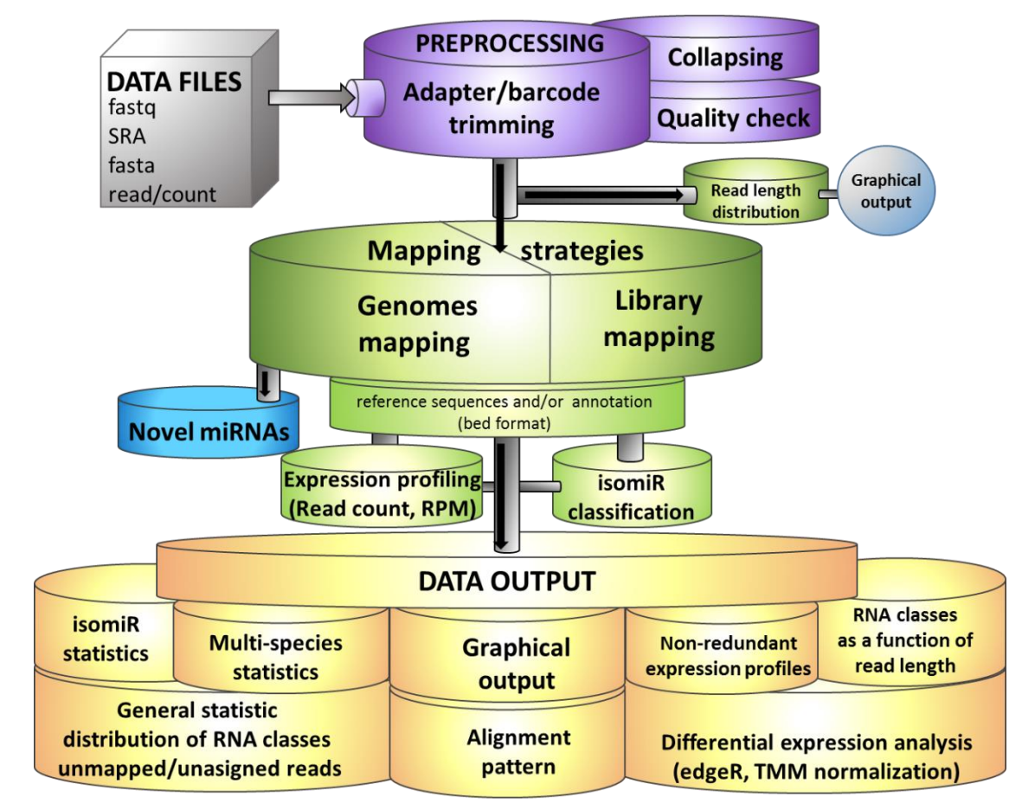
New pipeline
Comparison of Small RNA Analysis Tools with Plant & Animal Testing and Internal Open-Source Software
| Software | Inputs | Data Products | Comments | Plants | Animals | Open-Source Software | Research Paper Reference (First Authors, Year) | |---|---|---|---|---|---|---|---|---|
mirnaQC -> https://arn.ugr.es/mirnaqc/
sRNAbench -> https://arn.ugr.es/srnatoolbox/newbench/
sRNAblast -> https://arn.ugr.es/srnatoolbox/srnablast/
mirNOVO -> https://github.com/dvitsios/mirnovo?tab=readme-ov-file
sRNAde-> https://arn.ugr.es/srnatoolbox/srnade/

Slide 5
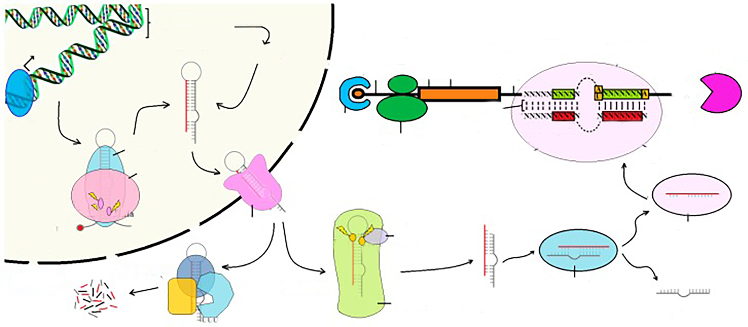
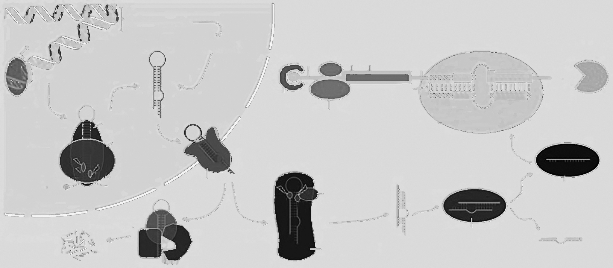
smallRNA processing
mirGene or intron
Complimentary targeting system
pre-microRNA
“Hairpin”
Splicing
Deadenylation
5’UTR
ORF CDS
3’UTR
Pri-miRNA
Exportin
Ribosome
‘Bulg’
‘Seed’ sequence
Processing
Dicer
(In plants)
Dicer (In animals)
microRNA duplex
mRISK
Nucleus
Cytoplasm
Maturation
Argonaute
Degradation
Figure 1: Regulator ncRNAs biogenesis landscape and functions in plants. The inside of the circle represents the nucleus, and the outside represents cytoplasm. All ncRNAs types are marked in purple. The background of each color represents biogenesis and functions of (A) miRNA; (B) siRNA; (C) tsRNA; (D) circRNA; (E) lncRNA, respectively. Reproduced from recent review by Campos ÁL, et al., (2016).

Slide 6
Analysis pipeline simplified for ASGSR / V1
Create Bowtie2 Index (Bowtie2, miRBase)
Raw Reads
Trim/Filter Raw Data (TrimGalore!)
Align Reads (Bowtie2)
Count Aligned Reads (samtools)
Create Raw Counts Table (R)
Normalize Counts (DESeq2)
cnosult
Raw Data QC (FastQC -> multiQC)
Trimmed Data QC (FastQC -> MultiQC)
Aligned Data QC (MultiQC of Logs)
Count Data QC (samtools -> MultiQC)
Differential Expression (DESeq2)
Consulting with ASGSR stake holders: Conclusion that mirDeep2 is the current community / industry standard

Slide 7
Tools compared: Cutadapt, TrimGalore, Seqkit
Alignment stages
Tools compared: BWA, Bowtie1 (BT1), Bowtie2 (BT2), BT1_BestStrata, BT2_VerySenitiveLocal, BT2_VerySensitive
Tools compared: Quantifier, SAMTOOLS IDXSTAT, RSEM, FeatureCount, HTseqCount.
Purpose: Remove adapter sequences, trim low-quality bases, and filter out low-quality reads
Output: Cleaned FASTQ files
Purpose: Compare alignment accuracy and quantity using a range of miRNA specific templates from mirBASE and mirGeneDB.
Output: Alignment files (SAM, BAM, BAI, BED)
Counting miRNA transcripts
Purpose: Identify variance in expression predictions caused by different combinations of filtering, aligning and quantification.
Output: table of miRNA transcript counts and fold changes (FC)
Trimming and filtering
Tools compared: DESeq2, EdgeR, Limma Trend, Limma Voom.
Purpose: Identify differentially expressed genes between different conditions or treatments
Output: DGE metrics, log-fold changes (FC), p-values, and adjusted p-values
Differential Expression Analysis
Databases compared: mirBASE.db , mirGeneDB, TarBase and BioMART
Purpose: Assign descriptions and details related to specific genomic features (e.g., miRNA).
Output: Name microRNA’s, mature/hairpins and their potential targets.
Annotation options
Visual assessment tools: MDS, Bar plot, PCA, Heatmap, ideogram and an example of Knowledge network mining (Knetminer).
Purpose: Opensource tools used to create sustainable FAIR results.
Output: Tables of statics for GeneLab data visualization system
Visualization

Slide 8
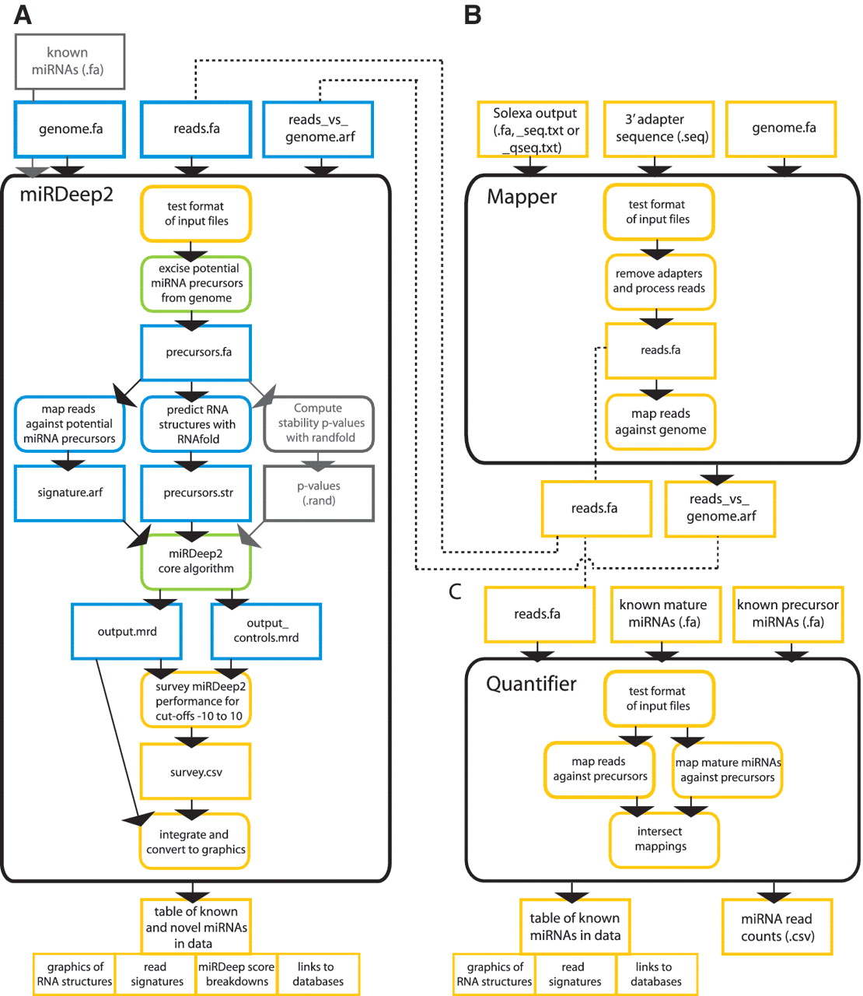
miRDeep2 accurately identifies known and hundreds of novel microRNA genes in seven animal clades
Figure 1. Flow charts of modules. Flow charts for (A) the miRDeep2 module (identifies known and novel miRNAs in high-throughput sequencing data), (B) the Mapper module (processes Illumina output and maps it to the reference genome) and (C) the Quantifier module (sums up read counts for known miRNAs in a sequencing data set). For each module the input, internal work flow (in black borders) and output is shown. Files are presented in rectangular boxes; processes are presented in rounded boxes. Files and processes that are novel to miRDeep2 are in yellow. Files and processes that have been modified are in green. Those that remain largely unchanged from the first version of miRDeep are in blue, while those that are optional are in grey. The file formats are: .fa, fasta; .arf, arf mapping format; .str, RNAfold output; .rand, randfold output; .mrd, miRDeep2 text output; .csv, csv spread-sheet; _seq.txt, raw sequence output from the Illumina platform; seq, sequence given on command line (see online documentation for description of formats). The ‘work flow of miRDeep2 modules’ results section contains detailed descriptions of all steps.
.

Slide 9
MirDeep2 progressed
Note: Uninstall anaconda
### MirDeep2 Environment Setup
# Ignore if MiniConda is installed
```bash
curl -LO https://repo.anaconda.com/miniconda/Miniconda3-latest-Linux-x86_64.sh
bash Miniconda3-latest-Linux-x86_64.sh
source ~/.bashrc
```
# Install and activate miRDeep2 environment using mamba
```bash
conda install -y -n base -c conda-forge mamba
mamba create -y -n mirdeep2 -c conda-forge -c bioconda -c defaults mirdeep2
conda activate mirdeep2
remove_white_space_in_id.pl ${sample}_trimmed.fastq > ${sample}_trimmed_no_space_pl.fastq
bowtie-build ${species}_no_space_pl.fa ${species}_no_space_pl
mapper.pl reads.fa -e -h -j -k TCGTATGCCGTCTTCTGCTTGT -l 18 -m -p SPECIES_no_space_pl \
-s reads_collapsed.fa -t reads_collapsed_vs_genome.arf -v -n
miRDeep2.pl reads_collapsed.fa SPECIES_genome.fa reads_collapsed_vs_genome.arf \
mature_ref_this_species.fa mature_ref_other_species.fa \
precursors_ref_this_species.fa -t SPECIES_ID 2> report.log

Slide 10
MirDeep2 progressed
remove_white_space_in_id.pl
**Out files**
- ${sample}_trimmed_no_space_pl.fastq
bowtie-build
Mapping performed on genome with “${species}_no_space_pl.fa”
**Out files**
Bowtie genome index, which consists of the following files for each SPECIES:
speciesi​ndexp​refix.1.bt2∗∗∗∗{species}_index_prefix.2.bt2 speciesi​ndexp​refix.3.bt2∗∗∗∗{species}_index_prefix.4.bt2 speciesi​ndexp​refix.rev.1.bt2∗∗∗∗{species}_index_prefix.rev.2.bt2
mapper.pl
**Out files**
reads_collapsed_vs_genome.arf
miRDeep2.pl
**Out files**
/results.html /.bed files /.txt files /.pdf files /.log files /.fa files*
mirbase.pl
**Out files**
- mature.fa
- precursors.fa
Remove_white_spaces_in_id.pl
Mirbase.pl
Extract_miRNA.pl
**Out files**
- mature_ref.fa
- precursors_ref.fa
Bowtie-build.pl
Extract_miRNA.pl
Remove_white_space_in_id.pl
**Out files**
- mature_ref.fa
- precursors_ref.fa
Remove_white_spaces_in_id.pl
Mapper.pl
mirDeep2.pl
Extraction of hsa-miR-10a-5p and hsa-let-7a-5p for ratio assessment

Slide 11
Tools compared: Cutadapt, TrimGalore, Seqkit
Alignment stages
Tools compared: BWA, Bowtie1 (BT1), Bowtie2 (BT2), BT1_BestStrata, BT2_VerySenitiveLocal, BT2_VerySensitive
Tools compared: mirDeep2_Quantifier, SAMTOOLS IDXSTAT, RSEM, FeatureCount, HTseqCount.
Purpose: Remove adapter sequences, trim low-quality bases, and filter out low-quality reads
Output: Cleaned FASTQ files
Purpose: Compare alignment accuracy and quantity using a range of miRNA specific templates from mirBASE and mirGeneDB.
Output: Alignment files (SAM, BAM, BAI, BED)
Counting miRNA transcripts
Purpose: Identify variance in expression predictions caused by different combinations of filtering, aligning and quantification.
Output: table of miRNA transcript counts and fold changes (FC)
Trimming and filtering
Tools compared: DESeq2, EdgeR, Limma Trend, Limma Voom.
Purpose: Identify differentially expressed genes between different conditions or treatments
Output: DGE metrics, log-fold changes (FC), p-values, and adjusted p-values
Differential Expression Analysis
Databases compared: mirBASE.db , mirGeneDB, TarBase and BioMART
Purpose: Assign descriptions and details related to specific genomic features (e.g., miRNA).
Output: Name microRNA’s, mature/hairpins and their potential targets.
Annotation options
Visual assessment tools: MDS, Bar plot, PCA, Heatmap, ideogram and an example of Knowledge network mining (Knetminer).
Purpose: Opensource tools used to create sustainable FAIR results.
Output: Tables of statics for GeneLab data visualization system
Visualization

Slide 12
MirDeep2 and mirDeep* accuracy
hsa-miR-10a-5p
hsa-let-7a-5p

Slide 13
MirDeep2 was most accurate
hsa-miR-10a-5p
hsa-let-7a-5p

Slide 14
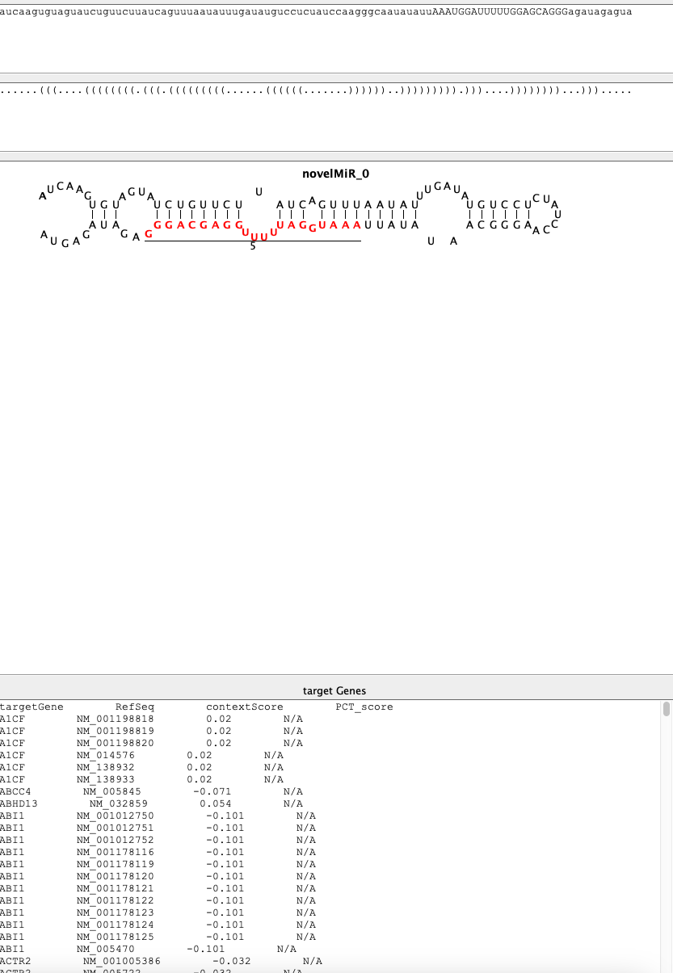
mirDeep* included mirTrace.jah for novel mir target prediction
http://www.australianprostatecentre.org/research/software/mirdeep-star
mirDeep* & An et al., (2012)
miRDeep*: an integrated application tool for miRNA identification from RNA sequencing data
doi: 10.1093/nar/gks1187
miRDeep*: an integrated application tool for miRNA identification from RNA sequencing data.
Identifies target genes of known and novel miRNAs are predicted using the TargetScan algorithm”
“compact Java version of the Bowtie alignment algorithm (18) where the index files are loaded chromosome by chromosome, instead of loading the entire chromosome index at once.”

Slide 15
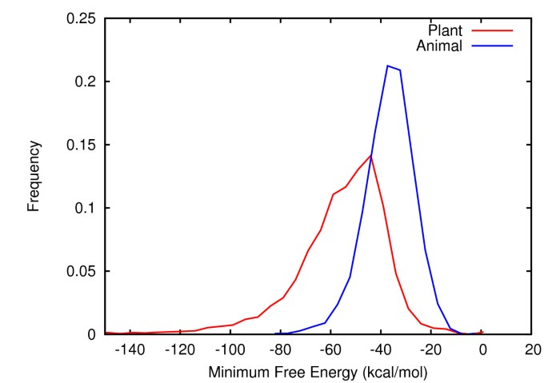
The Frequency distribution of Minimum Free Energy of all known miRNA precursors of plants and animals is different.
Thakur et al., (2011) Characterization of statistical features for plant microRNA prediction
A

Slide 16
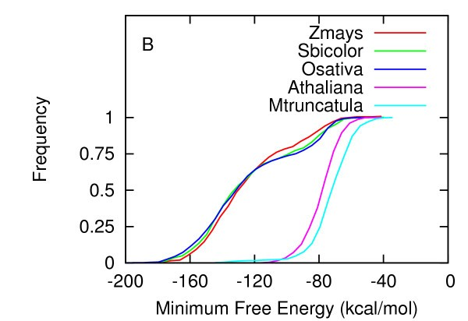
The Frequency distribution of Minimum Free Energy of all known miRNA precursors of monocots and dicots is different.
Thakur et al., (2011) Characterization of statistical features for plant microRNA prediction
A
B. Cumulative distribution of MFE of background precursor of size 260-90 nt from five plant species. The source species does affect the nature of distribution, and they tend to cluster into monocots and dicots. While the differences in distributions within the group were insignificant (at confidence level <0.05), those from two groups were highly significant.
Notes:
Z. mays, S. bicolor, and O. sativa.

Slide 17
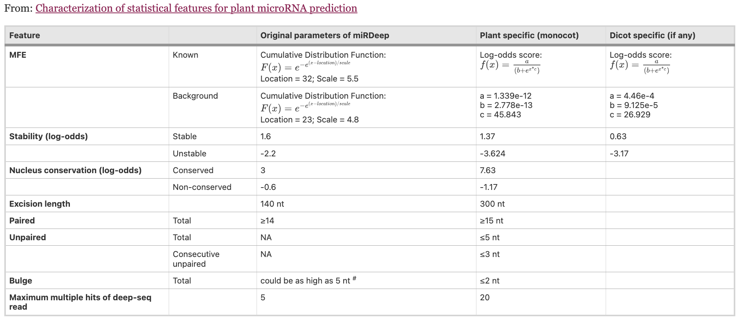
Analysis adaption for dicots and monocots
https://forgemia.inra.fr/martine.da-rocha/dicot_specific_mirdeep2
More information include how to convert to monocot
https://static-content.springer.com/esm/art%3A10.1186%2F1471-2164-12-108/MediaObjects/12864_2010_9944_MOESM5_ESM.DOC

Slide 18
Dicot_specific_mirDeep2
https://forgemia.inra.fr/martine.da-rocha/dicot_specific_mirdeep2
Adaptation of miRDeep2.0.0.5 for dicotyledons.
With replaced scripts in which parameters were optimized for dicot plants.
The parameters come from “Characterization of statistical features for plant microRNA prediction” –
Thakur, et al., (2011) https://bmcgenomics.biomedcentral.com/articles/10.1186/1471-2164-12-108
Note: It’s good, but apparently not as good as some of the other
The demo script uses C.elegans data ~ how odd?
Dicot_specific_mirDeep2 requires replacement of some scripts sanity_check_reads_ready_file.pl mapper.pl
miRDeep2.pl
excise_precursors.pl
excise_precursors_iterative_final.pl miRDeep2_core_algorithm.pl
 | miRDeep
 |  | Plants
Total unpaired | Up to 8 (for 22nt long miRNA) | Up to 5
Consecutive unpaired | Up to 8 | Only 3
Total bulge | Up to 5-6 | 1
Consecutive bases in bulge | Up to 5-6 | Nil
More details on the plant adaption
https://static-content.springer.com/esm/art%3A10.1186%2F1471-2164-12-108/MediaObjects/12864_2010_9944_MOESM5_ESM.DOC

Slide 19
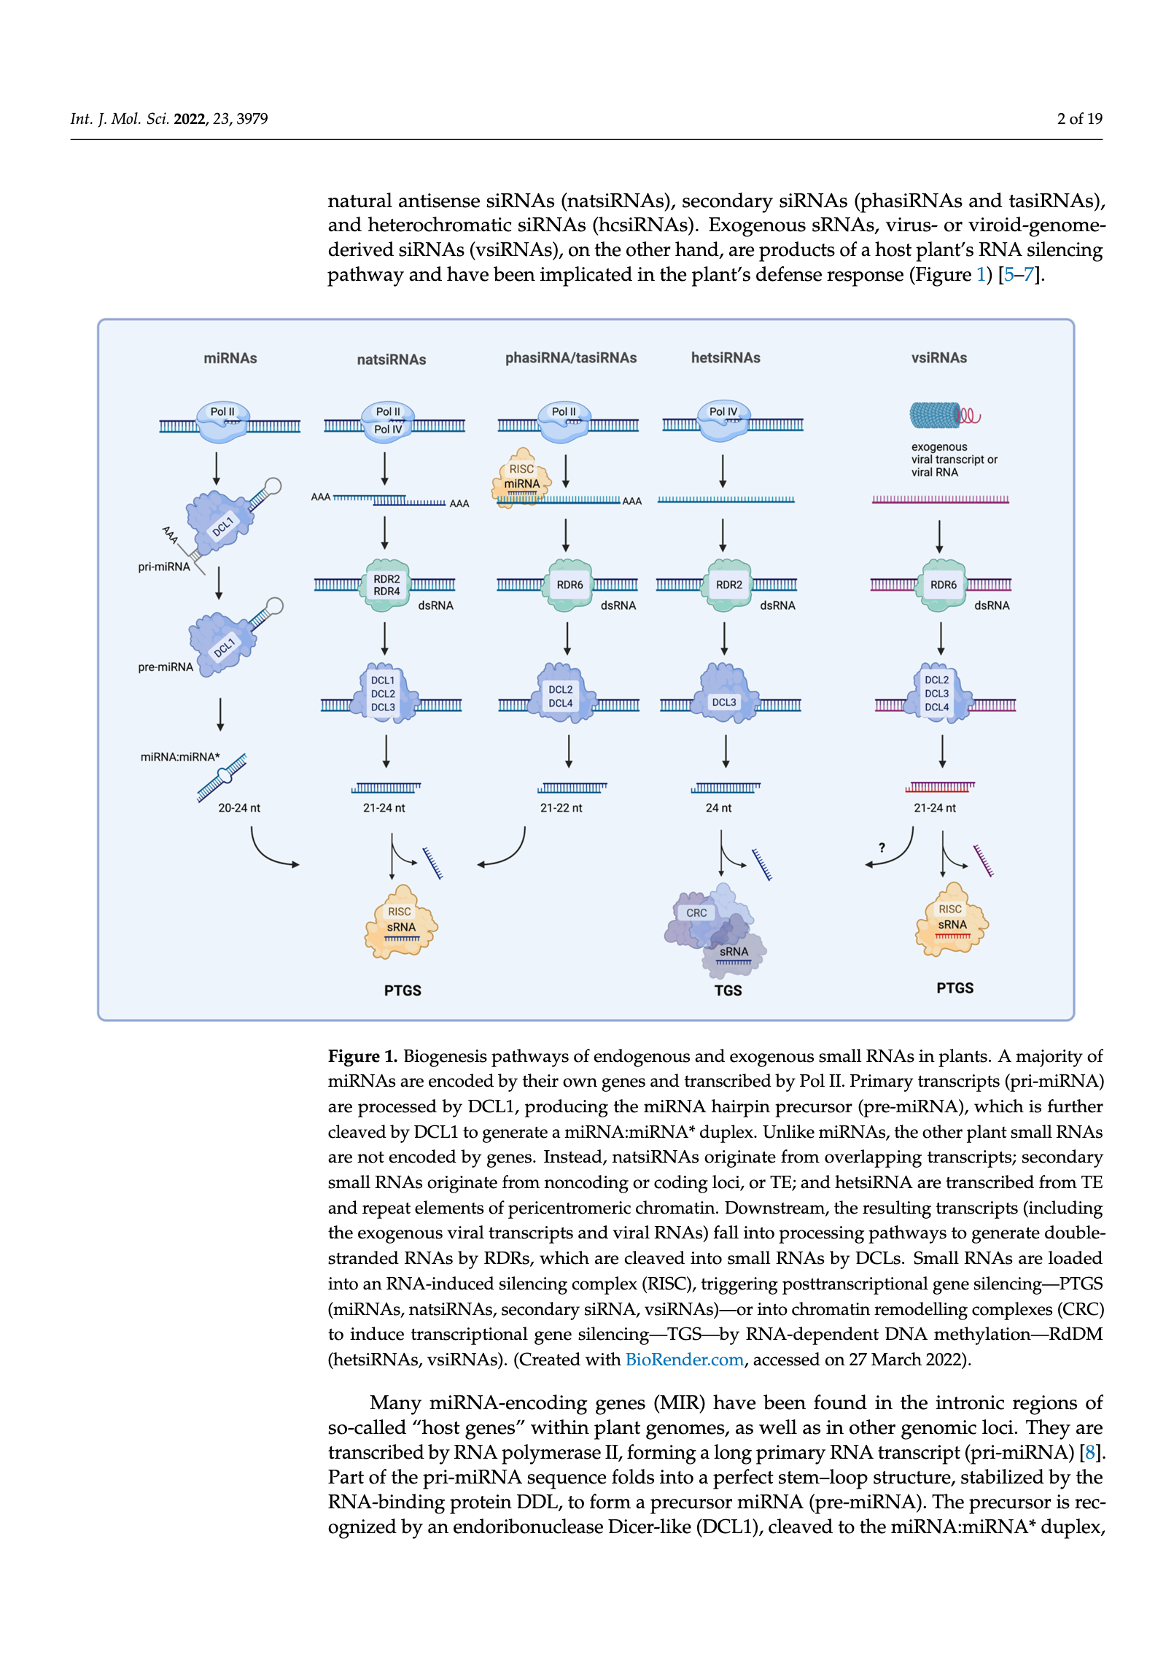
Plants have a lot of different types of small RNAs.
So what are the plant specific small RNA adaptions we need?
The Multiverse of Plant Small RNAs: How Can We Explore It? (2022)
International Journal of Molecular Sciences 23(7):3979
DOI: 10.3390/ijms23073979

Slide 20
Plant small rna genes DB provides them in .fa, .csv and .gff3
Lunardon et al. (2020) Genome Research https://doi.org/10.1101/gr.256750.119
Plant small RNA genes DB -> https://plantsmallrnagenes.science.psu.edu/index.php
Small non-coding RNAs (sRNAs) are typically 20–24 nucleotides (nt) in size but can be as large as 34nts.3
MicroRNAs (miRNAs) are small non-coding RNAs, with an average length of 22 nucleotides. Most miRNAs are transcribed from DNA sequences into primary miRNA transcripts, which are further processed to form mature miRNAs typically 21 or 22 nucleotides in length1 , 2
Short interfering RNAs (siRNAs) can be 21, 22, or 24 nucleotides long. Some siRNAs, like miRNAs, are 21 or 22 nucleotides long and can function to post-transcriptionally regulate mRNAs. Many more siRNAs are 24 nts in length and function to target chromatin-associated non-coding RNAs and reinforce repressive chromatin modifications3
Small noncoding RNAs (sncRNAs) comprise a family of noncoding RNAs with sizes ranging ~ 21–34 nucleotides (nt) that play a critical role in the regulation of gene expression and other cellular processes
 | ShortStack | miRBase | TAS_loci
MIRNA | 80 | 143 | 0
nearMIRNA | 6 | 8 | 0
siRNA20 | 12 | 0 | 0
siRNA21 | 248 | 63 | 24
siRNA22 | 23 | 3 | 0
siRNA23 | 23 | 2 | 0
siRNA24 | 11,349 | 75 | 0
OtherRNA | 8,388 | 27 | 3
NotExpressed | 0 | 4 | 0

Slide 21
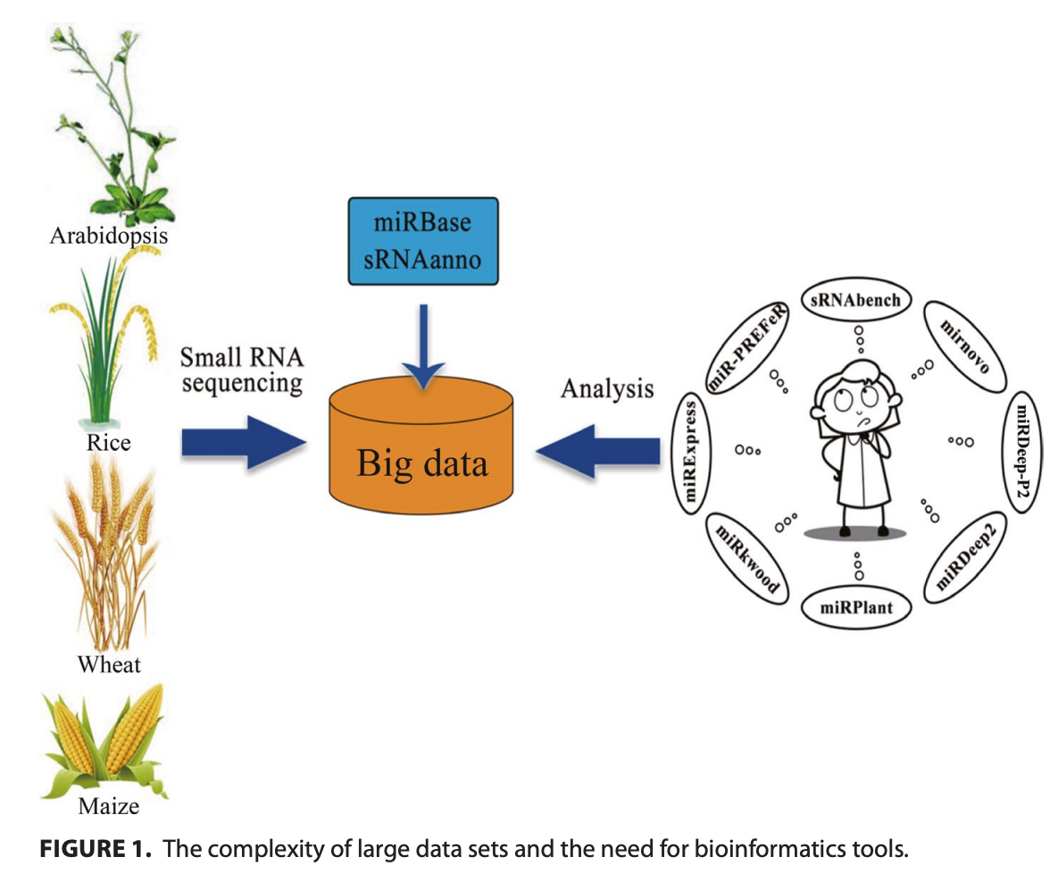
Based on the factors in this table I think mirDeep-P2 is the optimum replacement for mirDeep2 when analyzing plants
Li et al high sensitivity | Li et al worked on wheat | Has a web GUI | Has docker | Has mamba install | Galaxy instance | Quality of documents | Languages used
sRNAbench | Yes | Yes | Yes | No | No | High | Jar, python
mirExpress | Yes | No | No | No | No | NA / LOW | Peal / NA
miRkwood | NA | Yes | Yes | No | Yes | Medium | R, Js, Pearl
mirDeep-P2 | NA | No | Yes | Yes | No | Medium | Perl
mirDeep2 | Yes | No | Yes | Yes | No | Medium | Perl
PlantmirP2 | NA | No | Yes, but RNA fold fails in docker image |  | No | High | Perl, python, bash
IWA-miRNA (using mirDeeP2) | NA | Yes | Yes | No | Yes | Hihj | R, python, bash, perl

Slide 22
Summary pipeline V2 mirDeep2
TargetScan
Novel mir target prediction
MirBASE
Get mirBASE reference files, mirbase.pl
mirDeep2
Aligns Reads
mapper.pl
(BowtieBS)
Count Aligned Reads (mirDeep2.pl)
Create known Counts Table (R)
Known
https://www.targetscan.org/vert_80/
U-> T conversion
GeneLab Ref
Genome.fa
Index-reads_Genome.arf
Merged
Counts Table (R)
Normalize Counts (DESeq2)
Differential Expression (DESeq2)
multi-mir
Target database extraction
Species specific extract_miRNA.pl
mirDeep-P2
Aligns Reads
mapper.pl
(BowtieBS)
Count Aligned Reads (dicot_specific_mirDeep2.pl)
Create Novel mir Counts Table (R)
mirDeep2
Pearl
Remove white spaces.pl
Novel
Assess contaminationn Karaken2
PTarPmiR
Plant novel
mir target prediction
Create Bowtie2 Index (genome & miRBase mature)
Aligned_reads.bam
Plant specific adaptions
Raw Reads
Trim/Filter Raw Data (TrimGalore!)
Align Reads (Bowtie2)
Count Aligned Reads (samtools)
Raw Data QC (FastQC -> multiQC)
Trimmed Data QC (FastQC -> MultiQC)
Aligned Data QC (MultiQC of Logs)
Count Data QC (samtools -> MultiQC)
Script producing X
Intermediate file
Known microRNA
Novel microRNA

Slide 23
Summary pipeline V3 sRNAworkbench
TargetScan
Novel mir target prediction
MirBASE
Get mirBASE reference files, mirbase.pl
mirDeep2
Aligns Reads
mapper.pl
(BowtieBS)
Count Aligned Reads (mirDeep2.pl)
Create known Counts Table (R)
Known
U-> T conversion
GeneLab Ref
Genome.fa
Index-reads_Genome.arf
Merged
Counts Table (R)
Normalize Counts (DESeq2)
Differential Expression (DESeq2)
multi-mir
Target database extraction
Species specific extract_miRNA.pl
sRNA toolbox?
(BowtieBS)
Count Aligned Reads (dicot_specific_mirDeep2.pl)
Create Novel mir Counts Table (R)
mirDeep2
Pearl
Remove white spaces.pl
Novel
Assess contaminationn Karaken2
PTarPmiR
Plant novel
mir target prediction
Create Bowtie2 Index (genome & miRBase mature)
Aligned_reads.bam
Plant specific adaptions
Raw Reads
Trim/Filter Raw Data (TrimGalore!)
Align Reads (Bowtie2)
Count Aligned Reads (samtools)
Dicot_mirDeep2
Monocot_mirDeep2
miRDeep-P2
miRDP2
miRPlant
mirRkwood
miR-PREFeR
Mirnovo
sRNA toolbox
Raw Data QC (FastQC -> multiQC)
Trimmed Data QC (FastQC -> MultiQC)
Aligned Data QC (MultiQC of Logs)
Count Data QC (samtools -> MultiQC)
Script producing X
Intermediate file
Known microRNA
Novel microRNA

Slide 24
Summary pipeline V3 sRNAworkbench
MirBASE
Get mirBASE reference files, mirbase.pl
Create known Counts Table (R)
U-> T conversion
sRNA toolbox?
(BowtieBS)
Count Aligned Reads (dicot_specific_mirDeep2.pl)
Merged
Counts Table (R)
Normalize Counts (DESeq2)
Differential Expression (DESeq2)
multi-mir
Target database extraction
Species specific extract_miRNA.pl
Create Novel mir Counts Table (R)
GeneLab Ref
Genome.fa
Index-reads_Genome.arf
Plant specific adaptions
mirDeep2
Pearl
Remove white spaces.pl
Assess contaminationn Karaken2
Create Bowtie2 Index (Genome & miRBase mature)
Aligned_reads.bam
Raw Reads
Trim/Filter Raw Data (TrimGalore!)
Align Reads (Bowtie2)
Count Aligned Reads (samtools)
Raw Data QC (FastQC -> multiQC)
Trimmed Data QC (FastQC -> MultiQC)
Aligned Data QC (MultiQC of Logs)
Count Data QC (samtools -> MultiQC)

Slide 25
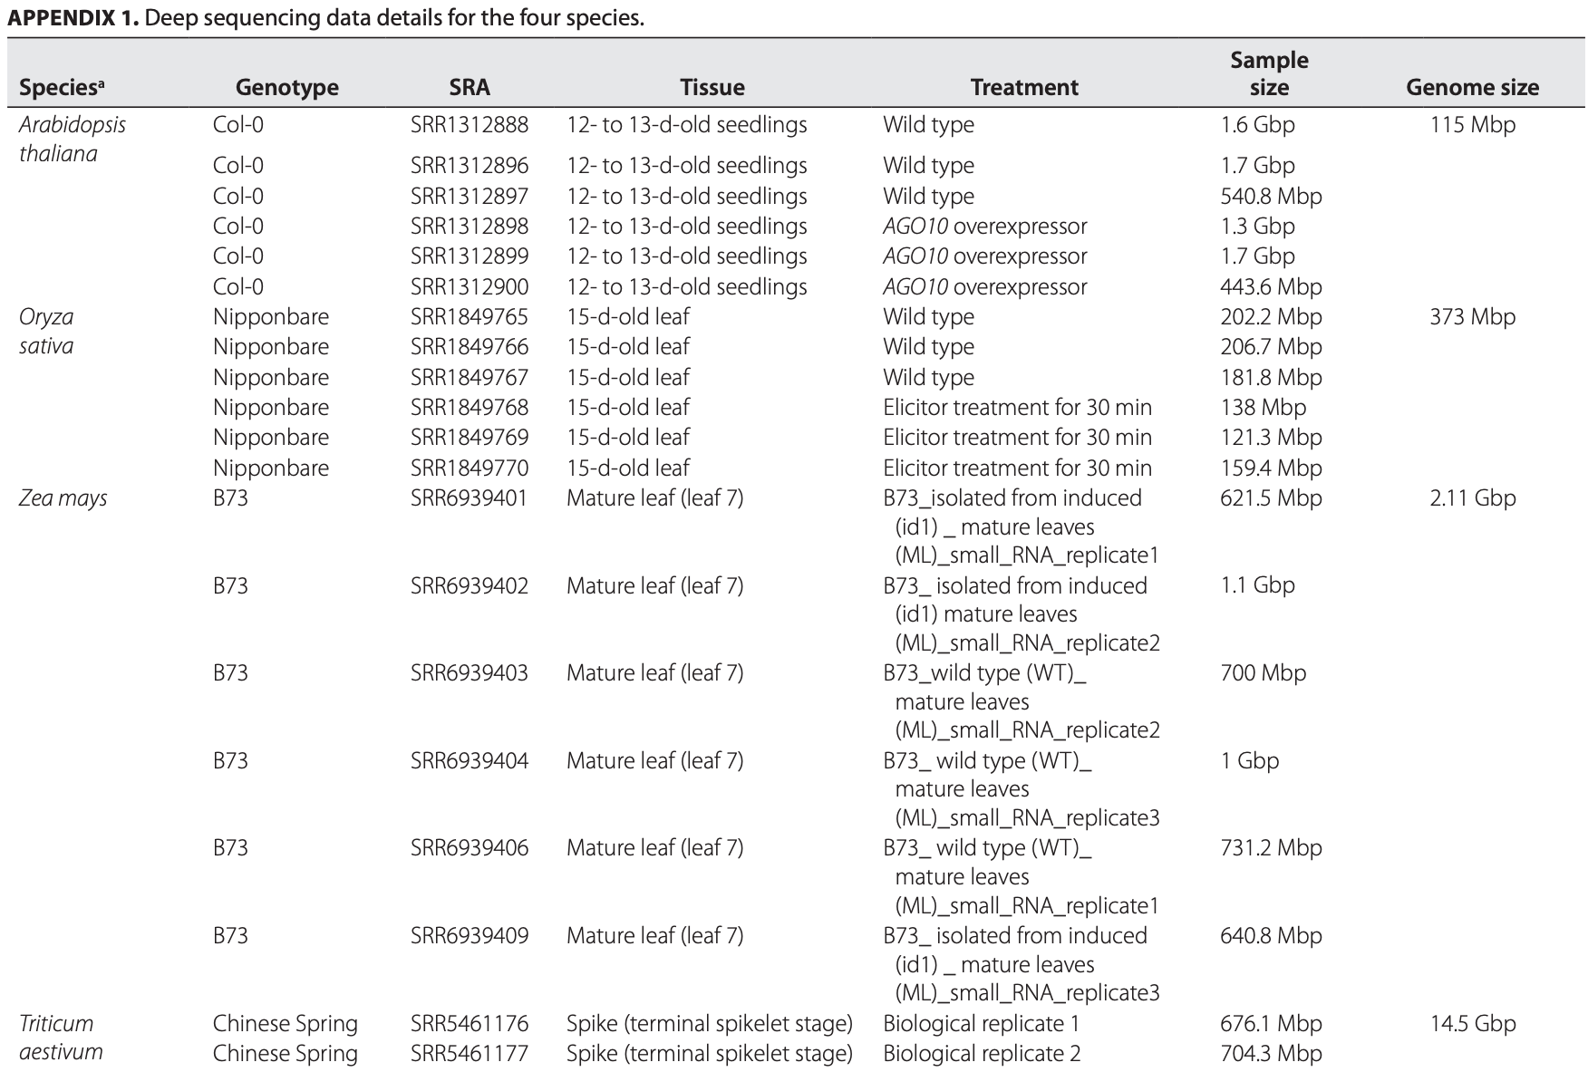
Note: SRA = Sequence Read Archive. The PubMed identification number (PMID) of each species is: Arabidopsis thaliana, 28231321; Oryza sativa, 26083154; Zea mays, 29688423; and Triticum aestivum, 28515146.
https://bsapubs.onlinelibrary.wiley.com/doi/pdf/10.1002/aps3.11414

Slide 26
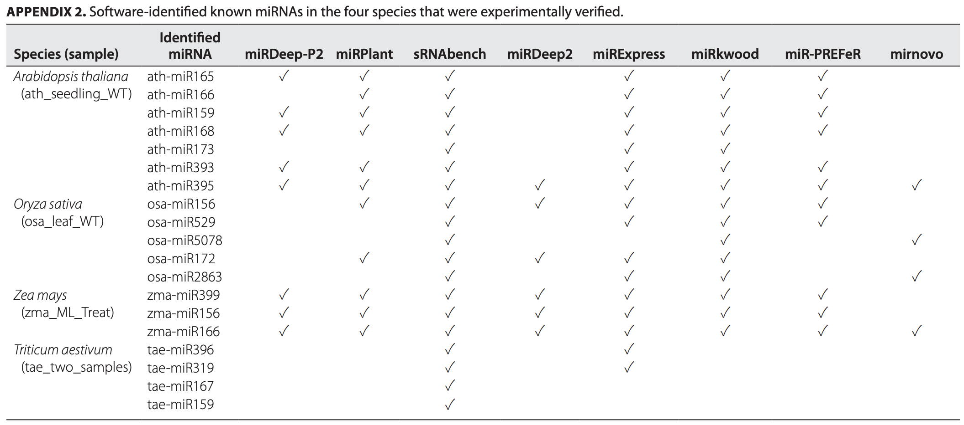
Note: SRA = Sequence Read Archive. The PubMed identification number (PMID) of each species is: Arabidopsis thaliana, 28231321; Oryza sativa, 26083154; Zea mays, 29688423; and Triticum aestivum, 28515146.
sRNAbench
mirExpress
miRkwood
mirDeep-P2
Sequence Read
https://bsapubs.onlinelibrary.wiley.com/doi/pdf/10.1002/aps3.11414

Slide 27
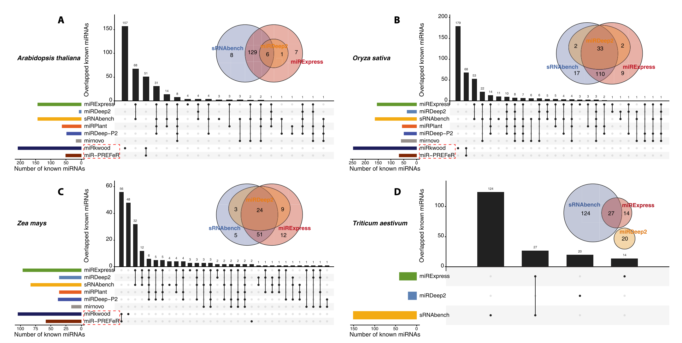
Note: SRA = Sequence Read Archive. The PubMed identification number (PMID) of each species is: Arabidopsis thaliana, 28231321; Oryza sativa, 26083154; Zea mays, 29688423; and Triticum aestivum, 28515146.
DRB winners!
sRNAbench
mirExpress
miRkwood
mirDeep-2
Not all pipielines tested on this wheat sample
FIGURE 4. UpSet plot and Venn diagrams of the known miRNAs. The programs in the red dashed boxes are used to predict known miRNA precursors; the rest of the software tools are used to predict known mature miRNAs. (A–C) Known miRNAs detected by all tools in Arabidopsis thaliana (A), Oryza sativa (B), and Zea mays (C). (D) Known miRNAs detected by sRNAbench, miRExpress, and miRDeep2 in Triticum aestivum. The UpSet plots show all intersections among all tools, while the Venn diagrams show the intersections among sRNAbench, miRExpress, and miRDeep2.
https://bsapubs.onlinelibrary.wiley.com/doi/pdf/10.1002/aps3.11414

Slide 28
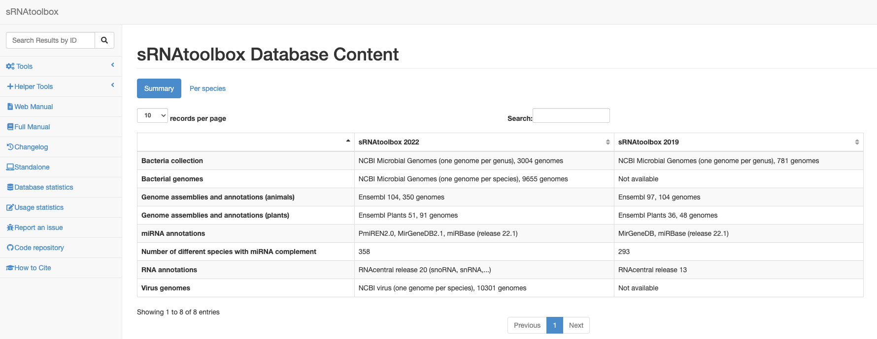
Li et al., (2020) Evaluation and application of tools for the identification of known microRNAs in plants
Conclusion on best performing mir detection tool(s)
MirExpress not available -> it evolved -> into the sRNAbench
“For researchers who have access to sufficient computer memory and want to identify more known miRNAs, we recommend using sRNAbench due to its accuracy and suitability for many species of different genome sizes”.
sRNA workbench: Can’t install docker without sudo-privileges ?
https://hub.docker.com/r/ugrbioinfo/srnatoolbox
Made a folder full of .JAR files -> not sure how to execute or use in pipeline
sRNA workbench warning: “We discourage the usage of “standalone” as several dependencies exist.”
The GUI looks nice
Other tools to try…
miRkwood -> new goal test -> Not nice documentation
miRDeep-P2_pipeline -> new goal -> Nice documentation
Li, Q., Liu, G., Bao, Y., Wu, Y., & You, Q. (2021). Evaluation and application of tools for the identification of known microRNAs in plants. Applications in Plant Sciences, 9(3), e11414. https://doi.org/10.1002/aps3.11414
https://bsapubs.onlinelibrary.wiley.com/doi/pdf/10.1002/aps3.11414
Notes:
Li, Q., Liu, G., Bao, Y., Wu, Y., & You, Q. (2021). Evaluation and application of tools for the identification of known microRNAs in plants. Applications in Plant Sciences, 9(3), e11414. https://doi.org/10.1002/aps3.11414

Slide 29
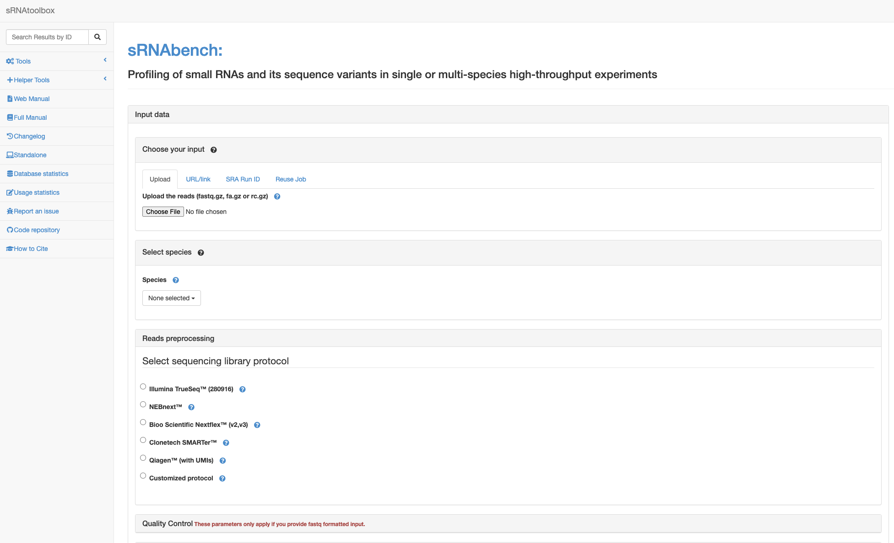
Tutorial
https://arn.ugr.es/srnatoolbox/srnabench/
Docker manual
https://arn.ugr.es/srnatoolbox/static/sRNAtoolbox_manual.pdf

Slide 30
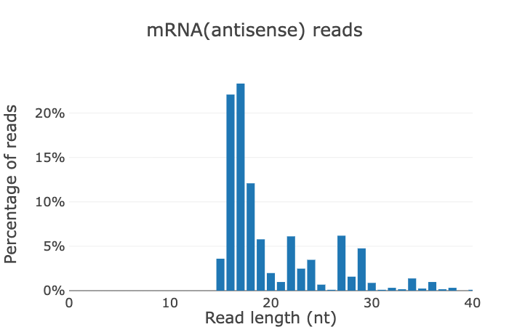
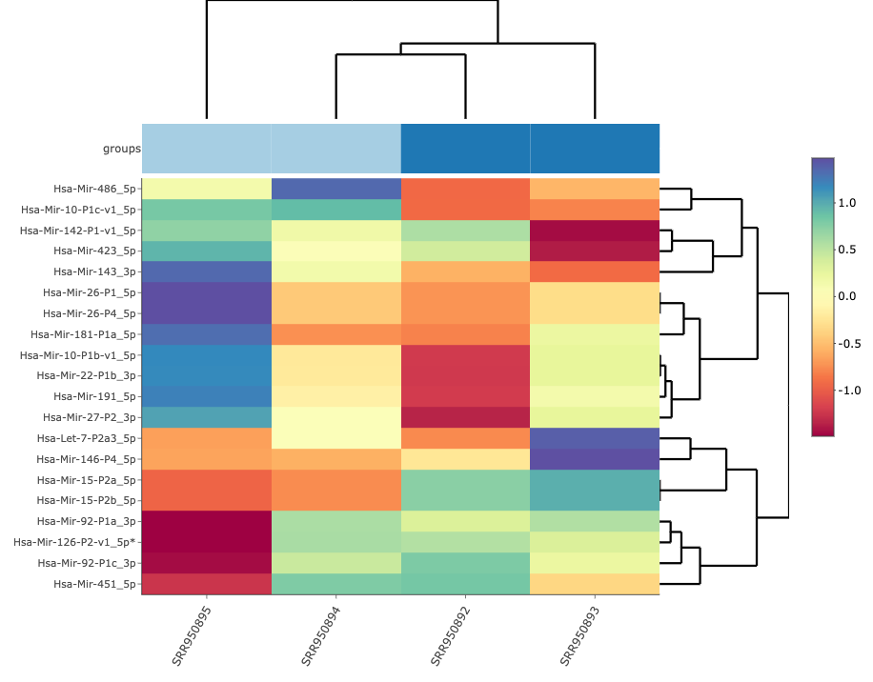
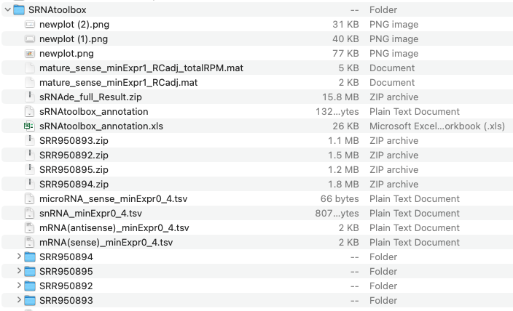
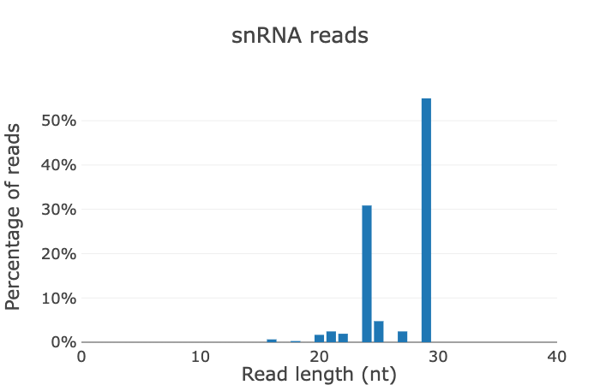
sRNAbench results

Slide 31
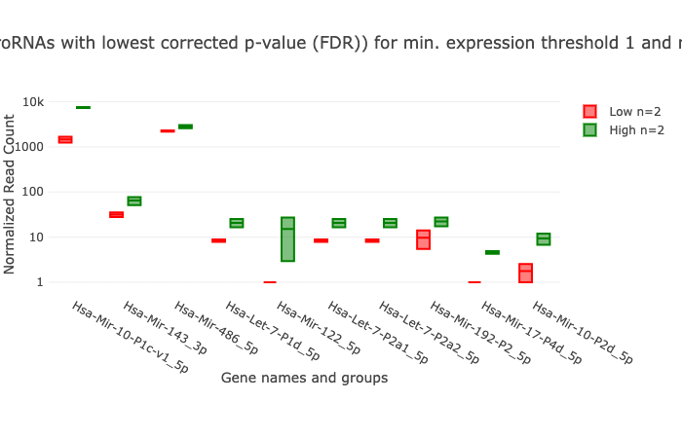
Target: hsa-MiR-10a-5p, hsa-let-7a-5p have slightly different names post sRNA workbench analysis
hsa-let-7a-5p
hsa-MiR-10a-5p
Note: sRNAbench. Add’s “P1v-v1”

Slide 32
sRNAbench is more accurate?
hsa-miR-10a-5p
hsa-let-7a-5p

Slide 33
sRNAbench is more accurate?
hsa-miR-10a-5p
hsa-let-7a-5p

Slide 34
But I couldn’t get smallRNAbench to work via command line.
https://github.com/dr-richard-barker/SRNA_toolbox/blob/main/sRNA_toolbox_Code.md
The online version uses a NCBI parser tool required for formatting input file, I can’t find it in their command line options so is only available through their GUI.
So if you’re going to use smallRNAbench then just use their GUI.
Consensus miRNA target predictions tools are still appealing
java -jar miRNAconsTargets.jar
java -jar miRNAconsTargets_plants.py
miRDeep-P2_pipeline installation implied it should work as a plant branch and is written in pearl.
So the mirDeep2 pipeline with a mirKWood plant branch might make more sense.

Slide 35
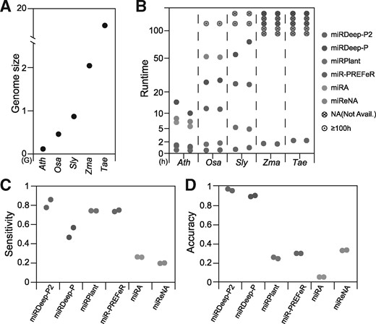
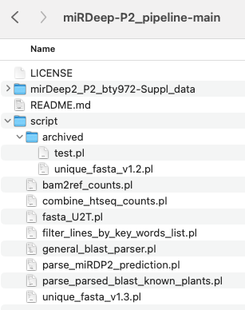
https://github.com/TF-Chan-Lab/miRDeep-P2_pipeline
miRDeep-P2_pipeline -> new goal -> Test
-> https://github.com/TF-Chan-Lab/miRDeep-P2_pipeline
-> https://sourceforge.net/projects/mirdp2/
https://bioconda.github.io/recipes/mirdeep-p2/README.html
mamba install mirdeep-p2
conda install -c bioconda mirdeep-p2
https://sourceforge.net/projects/mirdp2/.
Kuang, Z., Wang, Y., Li, L., & Yang, X. (2019). MiRDeep-P2: Accurate and fast analysis of the microRNA transcriptome in plants. Bioinformatics, 35(14), 2521-2522. https://doi.org/10.1093/bioinformatics/bty972

Slide 36
miRDeep-P2_pipeline -> new goal -> Test
-> https://github.com/TF-Chan-Lab/miRDeep-P2_pipeline
-> https://sourceforge.net/projects/mirdp2/
“miRDeep-P2 (miRDP2) is developed to accurately and fast analyze microRNAs (miRNAs) transcriptome in plants. It is adopted from miRDeep-P (miRDP) with new strategies and overhauled algorithm. We have tested miRDP2 to analyze miRNA transcriptomes in such plants with gradually increased genome size as Arabidopsis, rice, tomato, maize and wheat. By incorporating newly updated plant miRNA annotation criteria, the accuracy of miRDP2 is also markedly improved. Our results demonstrate miRDP2 as a fast and accurate tool for analyzing the miRNA transcriptome in plants”. https://sourceforge.net/projects/mirdp2/ (not good?)
https://github.com/TF-Chan-Lab/miRDeep-P2_pipeline/tree/main/script
Reference: https://doi.org/10.1093/bioinformatics/bty972

Slide 37
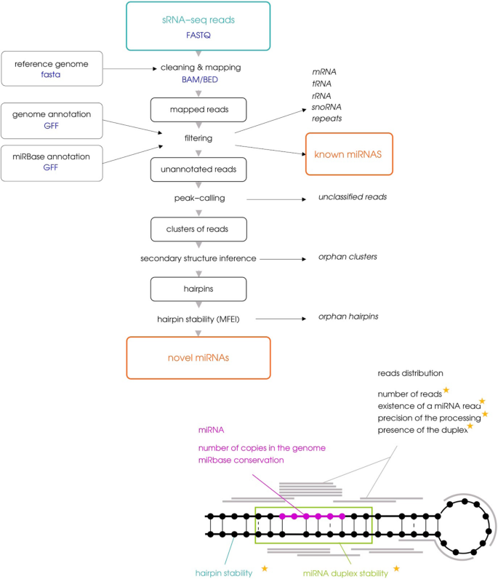
The other contender in the literature is “miRkwood”: a tool for the reliable identification of microRNAs in plant genomes
NotE: I’m not a fan of their tutorials!! But written in perl so shouldfollow the same format as mirDeep2.
Source: https://bioinfo.cristal.univ-lille.fr/cgi-bin/mirkwood/web_scripts/interface.pl
Paper: https://bmcgenomics.biomedcentral.com/articles/10.1186/s12864-019-5913-9
https://github.com/miRkwood-RNA/miRkwood
https://hub.docker.com/r/iguigon/mirkwood/

Slide 38
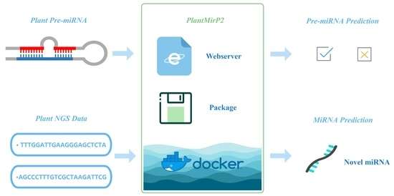
Another options is “PlantMirP2”
https://www.mdpi.com/2073-4425/12/8/1280
The github repo-> ”is minimal” https://github.com/wuqiansibai/plantMiRP2/releases/tag/v1.0
a Dockerfile https://github.com/wuqiansibai/plantMiRP2/releases/tag/Dockerfile
Web-server version “not found” is worrying -> : http://plantmi.top/

Slide 39
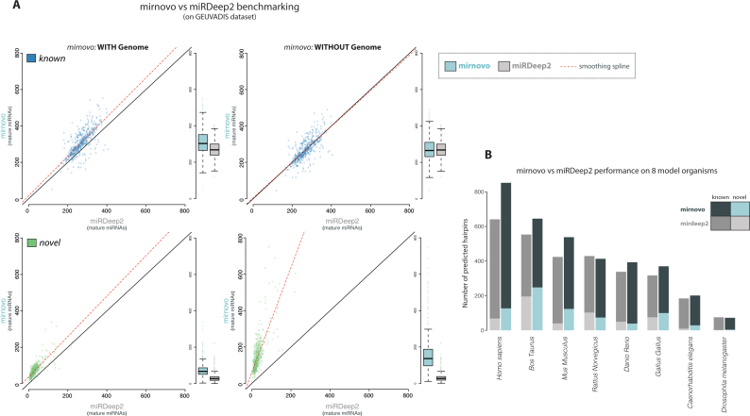
mirNOVO machine learning might be the way?
This method is available as both a web-application (http://wwwdev.ebi.ac.uk/enright-dev/mirnovo) and a stand-alone tool (https://github.com/dvitsios/mirnovo). The coverage profiles and hairpin precursors of all predicted novel miRNAs in the GEUVADIS samples are available at the following link:
http://wwwdev.ebi.ac.uk/enright-dev/mirnovo-standalone-pkg/misc/geuvadis-analysis.
https://pubmed.ncbi.nlm.nih.gov/29036314/

Slide 40
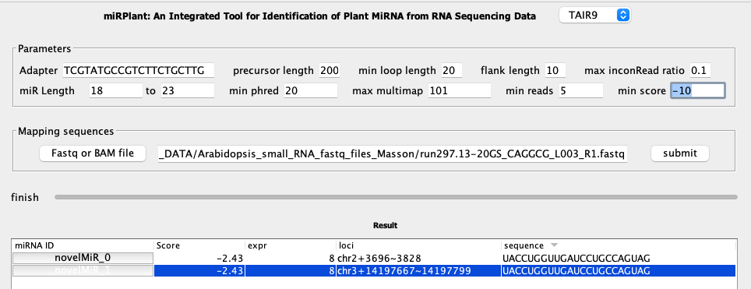
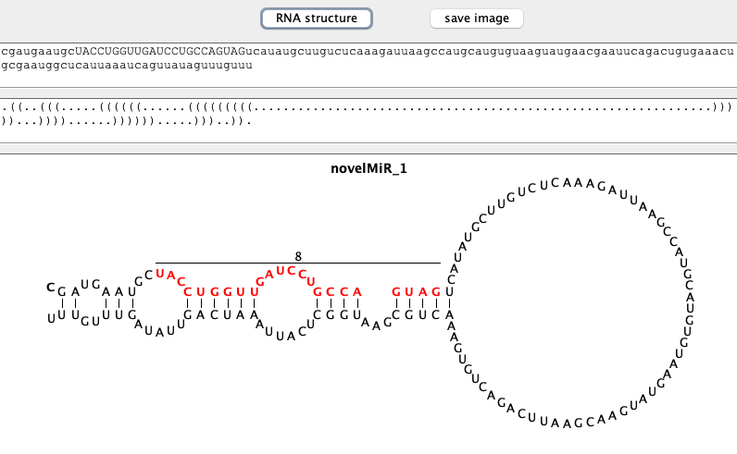
miRPlant GUI was tested and it was able to predict novel mir targets in plants
http://www.australianprostatecentre.org/research/software/mirplant
miRPlant did not produce targets of novel microRNA predictions.
Also, didn’t provide quantification of known microRNAs.
Tangent . Ignore?
An J, Lai J, Sajjanhar A, Lehman ML, Nelson CC: miRPlant: an integrated tool for identification of plant miRNA from RNA sequencing data. BMC bioinformatics 2014, 15(1):275.
Notes:
miRPlant
An Integrated Tool for Identification of Plant MiRNA from RNA Sequencing Data
Small RNA sequencing has been commonly used to identify novel miRNAs and their expression levels in plants. There are several miRNA identification tools for animals such as miRDeep, miRDeep2 and miRDeep*. miRDeep-P was developed from miRDeep for plants using miRDeep’s probabilistic model of miRNA biogenesis. However, it is necessary to use a different strategy to find suitable hairpin regions in the plant genome since plant miRNAs have much longer precursor miRNA than those in animal. Thus, we have developed miRPlant which extends miRDeep* to various plant species by adopting suitable strategies to identify hairpin excision regions and hairpin structure filtering for plants. Similar to miRDeep*, miRPlant does not require any third party tools such as mapping or RNA secondary structure prediction tools. In addition, miRPlant uses a graphic user interface for data input and output, and identified miRNA is displayed with all RNAseq reads in a hairpin diagram. This tool can be easily used by biologists without much computer knowledge.

Slide 41
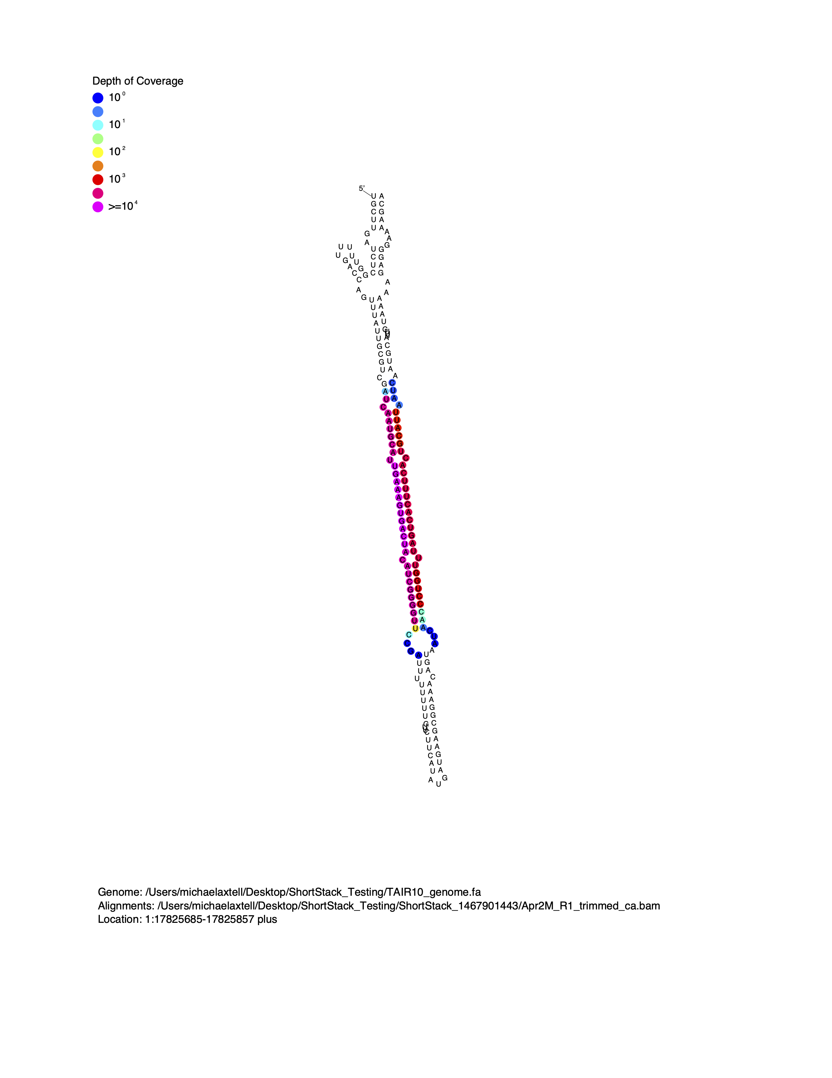
strucVis is python & perl code that makes a visualization of the predicted small RNA structure
Not nessary but would be cool
https://github.com/MikeAxtell/strucVis
perl5 (available at /usr/bin/env perl)
samtools (installed in your PATH)
RNAfold (installed in your PATH)

Slide 42
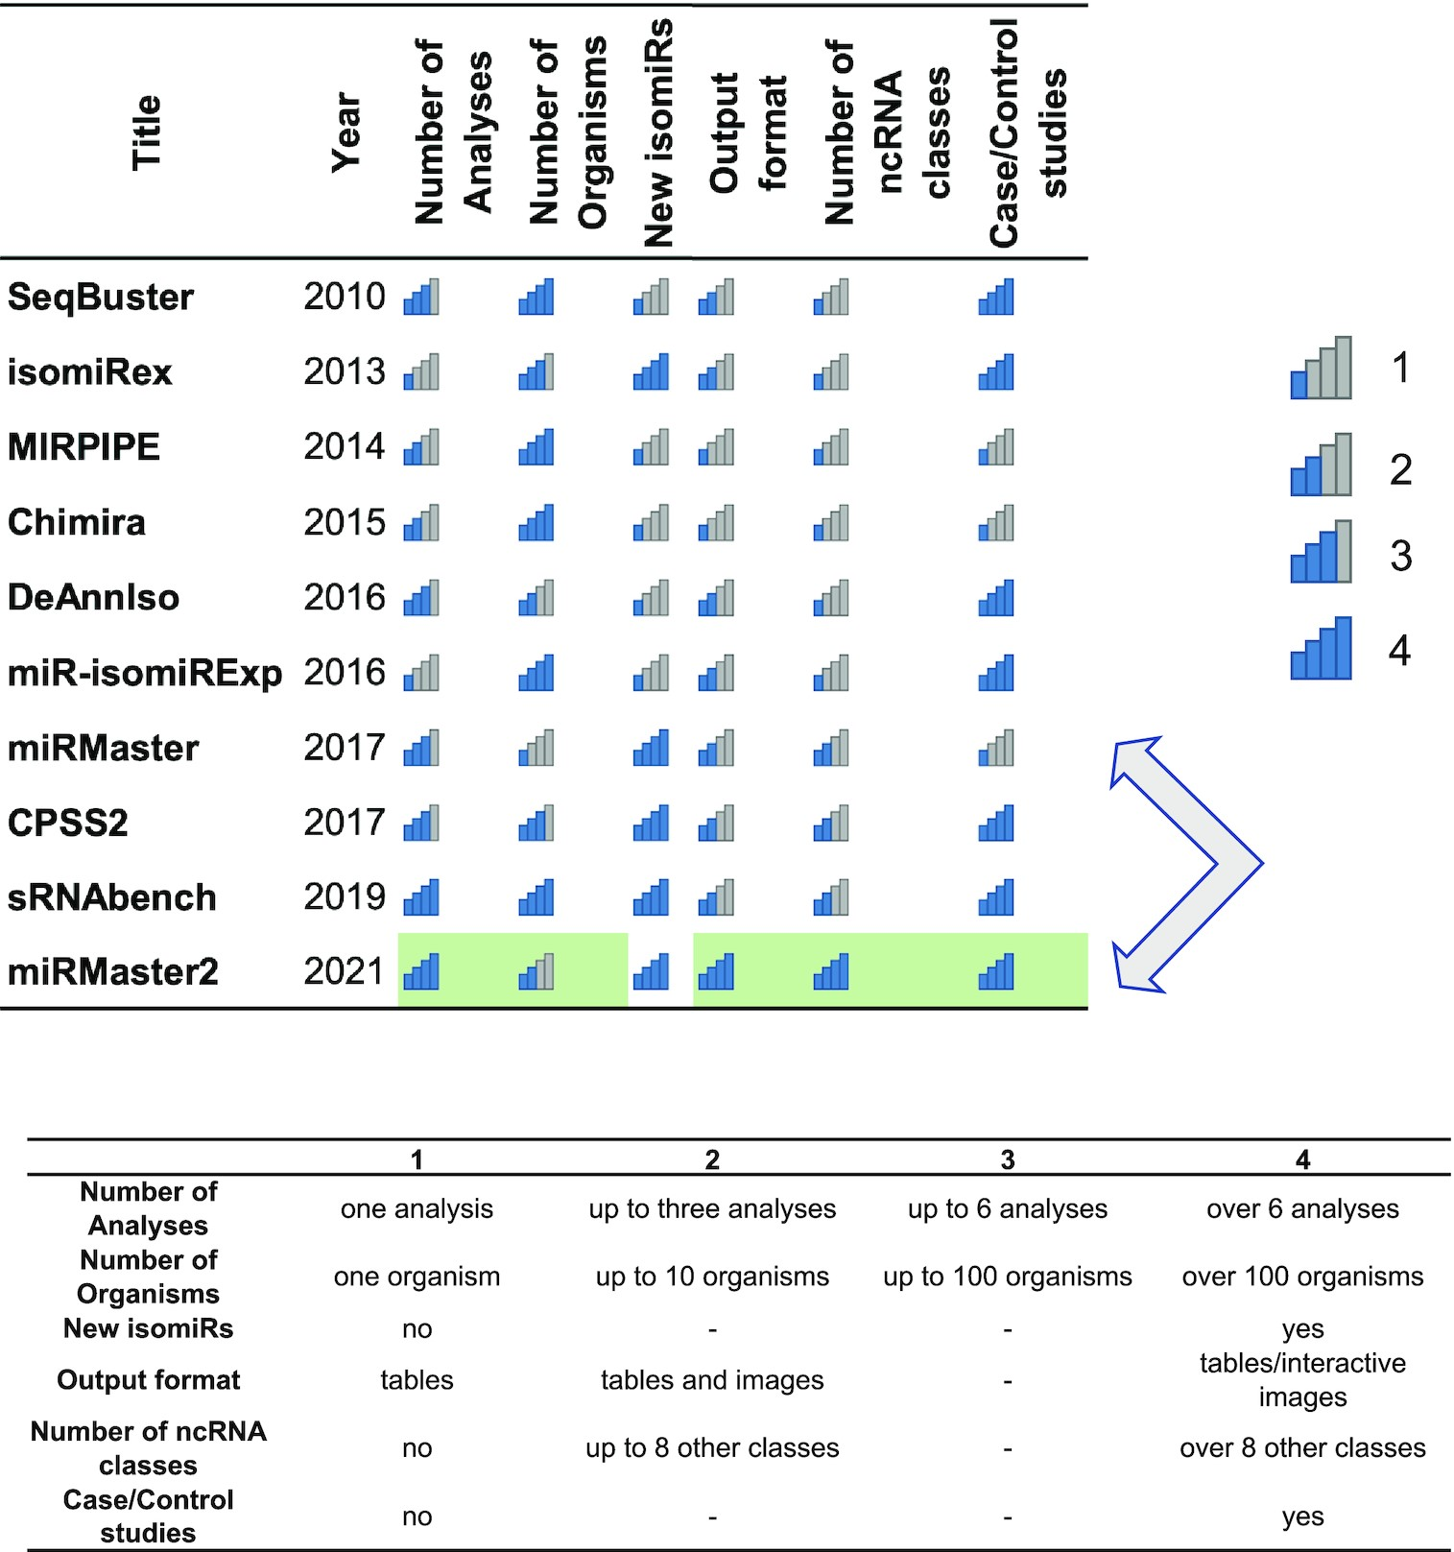
miRMaster 2 is freely available at https://www.ccb.uni-saarland.de/mirmaster2.
If you used miRMaster in your work please cite:
T. Fehlmann, F. Kern, O. Laham, C. Backes, J. Solomon, P. Hirsch, C. Volz, R. Müller, A. Keller; miRMaster 2.0: multi-species non-coding RNA sequencing analyses at scale Nucleic Acids Res 2021. doi: 10.1093/nar/gkab268
This paper compares sRNAbench to other mirtools ->

Slide 43
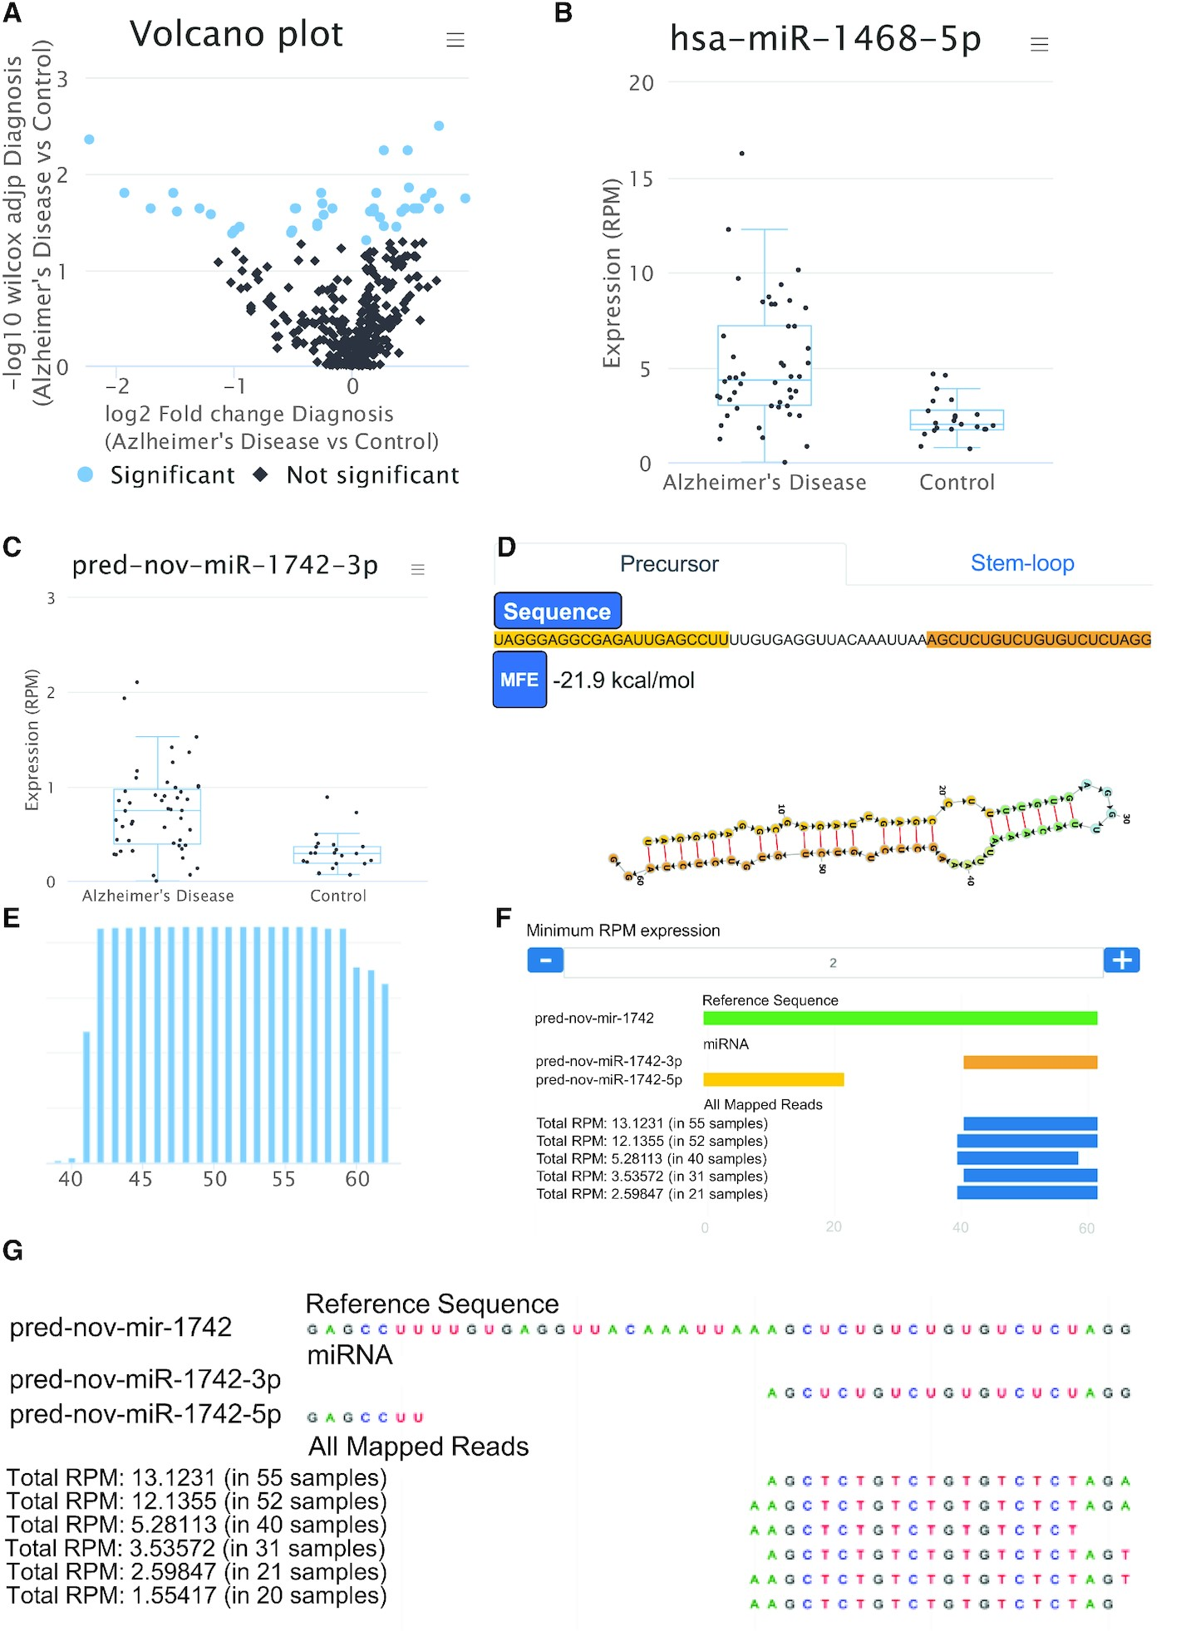
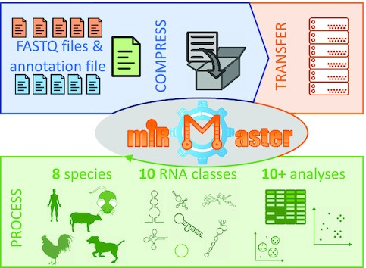
It looks really good but I can’t find github repo or any other code deposit or command line tutorial
miRMaster 2 is freely available at https://www.ccb.uni-saarland.de/mirmaster2.
If you used miRMaster in your work please cite:
T. Fehlmann, F. Kern, O. Laham, C. Backes, J. Solomon, P. Hirsch, C. Volz, R. Müller, A. Keller; miRMaster 2.0: multi-species non-coding RNA sequencing analyses at scale Nucleic Acids Res 2021. doi: 10.1093/nar/gkab268

Slide 44
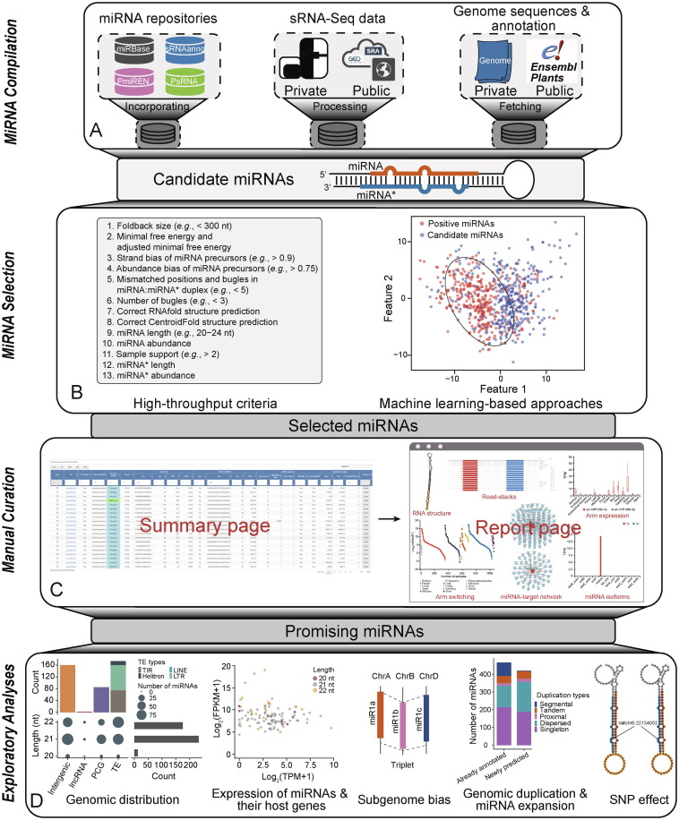
IWA-miRNA
Galaxy
http://omicstudio.cloud:4005/
Code availability
iwa-miRNA Docker image is available at https://hub.docker.com/r/malab/iwa-mirna.
Source codes and user manuals are available at https://github.com/cma2015/iwa-miRNA
Zhang, T., Zhai, J., Zhang, X., Ling, L., Li, M., Xie, S., Song, M., & Ma, C. (2022). Interactive Web-based Annotation of Plant MicroRNAs with iwa-miRNA. Genomics, Proteomics & Bioinformatics, 20(3), 557-567.
https://doi.org/10.1016/j.gpb.2021.02.010

Slide 45
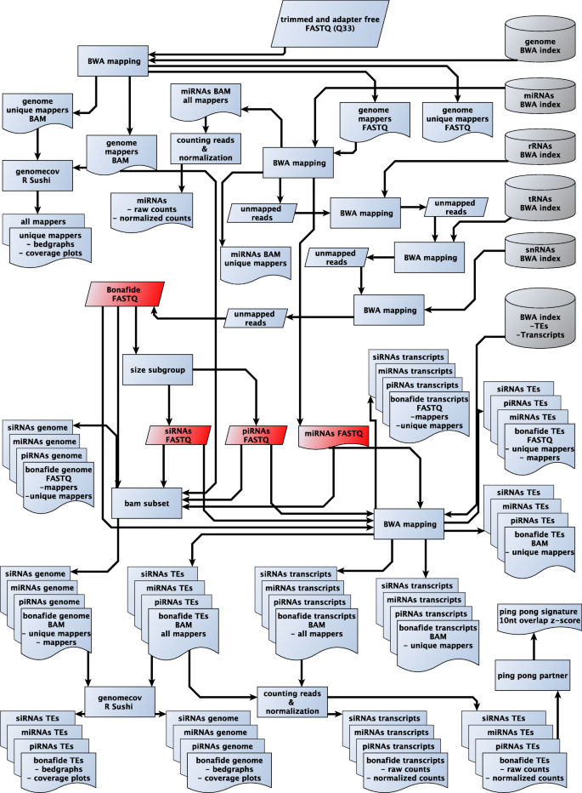
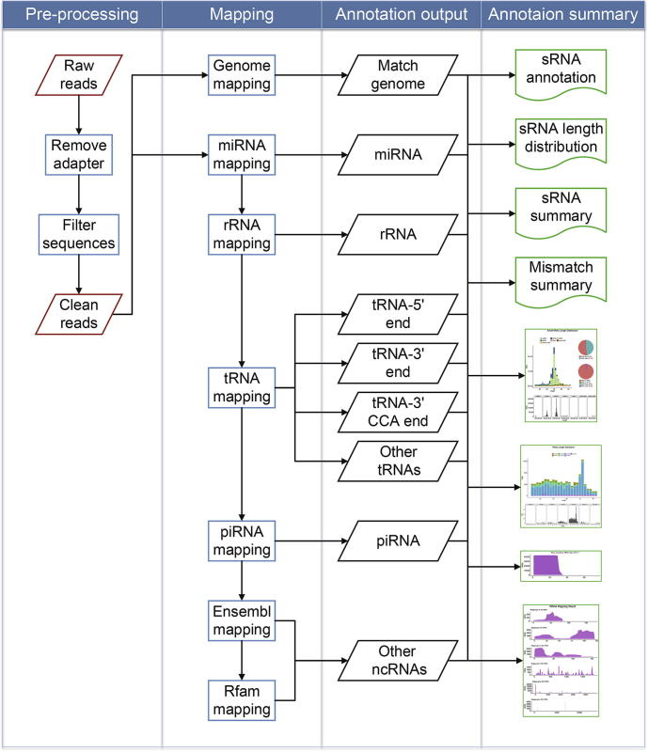
https://github.com/junchaoshi/sports1.0
sRNAPipe: a Galaxy-based pipeline for bioinformatic in-depth exploration of small RNAseq data
https://github.com/junchaoshi/sports1.0
SPORTS1.0 can apply to a wide-range of species and the annotation references of 68 species are precompiled for downloading (Table S1).
https://mobilednajournal.biomedcentral.com/articles/10.1186/s13100-018-0130-7#Fig2

Slide 46
Quantification description
Deep dive mirDeep2 and mirDeep* alignment and quantification sequence.
Confirm versions of bowtie used during alignment?
Is there a way to make a BAM or SAM file from the mirDeep2 scripts?
Is .arf ok for the community as an alternative out put (Ask AWG)?
Find studies for other animal to test dive with mirDeep2 and mirDeep*
Get a tests datasets: are there synthetic spiked options ?
C.elegans
D.melanogaster
Plant deep dive
Get a tests datasets: are there synthetic spiked options ?
Monocot
Dicot

Slide 47
Source of plant data sets
Arabidopsis thaliana. (A–F) SRR1312888 (A), SRR1312898 (B), SRR1312896 (C), SRR1312899 (D), SRR1312897 (E), and SRR1312900 (F).
Oryza sativa. (A–D) SRR1849766 (A), SRR1849769 (B), SRR1849767 (C), and SRR1849770 (D).
Zea mays. (A–F) SRR6939406 (A), SRR6939401 (B), SRR6939403 (C), SRR6939402 (D), SRR6939404 (E), and SRR6939409 (F).
“Evaluation and application of tools for the identification of known microRNAs in plants”
https://bsapubs.onlinelibrary.wiley.com/doi/pdf/10.1002/aps3.11414
Li et al., (2020)

Slide 48
Conclusion
In conclusion, a small RNAseq analysis pipeline was optimized for the analysis of microRNA sequencing data. The minimal pipeline includes quality control, alignment, quantification and differential expression analysis. The pipeline was optimized using multiple tools and parameters. The accuracy of the results were compared to select the best approach, revealing increased accuracy and easier interpretation when microRNA specific libraries were used as templates instead of just using genome alignments. The pipeline provides an efficient solution for small RNA analysis using *.fastq files from either smallRNAseq or total RNAseq as inputs.

Slide 49
References
Campos ÁL, et al., (2016). Tools for Sequence-Based miRNA Target Prediction: What to Choose? Int J Mol Sci. 9;17(12):1987.
Ziemann M, Kaspi A, El-Osta A. (2016) Evaluation of microRNA alignment techniques. RNA. 22(8): 1120–1138.
Griffiths-Jones, Grocock, van Dongen, Bateman, and Enright (2006). miRBase: microRNA sequences, targets and gene nomenclature. Nucleic Acids Res. 1;34 (Database issue).
Sethupathy, Corda, and Hatzigeorgiou (2006). TarBase: A comprehensive database of experimentally supported animal microRNA targets. RNA. 12(2):192-7.
Love MI, Huber W, Anders S (2014). Moderated estimation of fold change and dispersion for RNA-seq data with DESeq2. Genome Biology, 15, 550.
Hassani-Pak et al., (2021). KnetMiner: a comprehensive approach for supporting evidence-based gene discovery and complex trait analysis across species. Plant Biotechnol Journel. 1670-1678. doi: 10.1111/pbi.13583.
https://academic.oup.com/nar/article/40/1/37/1275937
“Characterization of statistical features for plant microRNA prediction” –
Thakur, et al., (2011) https://bmcgenomics.biomedcentral.com/articles/10.1186/1471-2164-12-108
mirDeep* & An et al., (2012) miRDeep*: an integrated application tool for miRNA identification from RNA sequencing data. doi: 10.1093/nar/gks1187
miRDeep*: an integrated application
http://www.australianprostatecentre.org/research/software/mirdeep-star
http://www.australianprostatecentre.org/research/software/mirplant
https://forgemia.inra.fr/martine.da-rocha/dicot_specific_mirdeep2

Slide 50
miRDeep2 resultsXXXX.csv contains 4 tables, these can be split with the following command. Future work: “make a loop that addes the sample name”
Future tangents Compiling data challenge
awk -v RS= -v PATTERN="result_04_12_2023_t_11_25_34" '{FILE=sprintf("%s-%d.csv", PATTERN, NR); print > FILE}' "/Users/rjbarker/mirdeep2/V5_Test_run_local_version_WORKED_locally/result_04_12_2023_t_11_25_34.csv”
Bind counts (2 tables)
1 for known microRNA
2 for novel microRNA
Parse to DESeq2 with factors table
(2x once for known and again for novel?)

Slide 51
DRB to-do list for miRNA analysis:
Deep-Dive into mirDeep2 and mirDeep* Tools
Thoroughly review the documentation for mirDeep2 and mirDeep* to understand their algorithms, dependencies, and output formats.
Compare the alignment and quantification methodologies of both tools.
Version Confirmation and Compatibility of Bowtie versions
Verify the versions of bowtie (or other alignment tools) compatible with the current versions of mirDeep2 and mirDeep* to ensure optimal functionality.
Check for any updates or patches that might affect performance or results.
File Conversion and Output Management
Investigate the possibility of generating BAM or SAM files directly from mirDeep2 scripts, potentially writing a custom script if necessary.
Evaluate the acceptance of .arf files within the bioinformatics community and consult with the Analysis Working Group (AWG) for standard practices.
Cross-Species Analysis Exploration
Identify published studies that have used mirDeep2 and mirDeep* for non-human animal miRNA analysis to gather insights on cross-species applicability.
Acquire datasets for C. elegans, D. melanogaster, and other relevant species for comparative studies.
Test Dataset Procurement
Source test datasets for both animal and plant miRNA analysis. Look for synthetic datasets with spiked-in controls to aid in method validation.
Ensure datasets cover a range of complexity, including monocots and dicots for plant studies.
Experimental Design and Validation
Design a series of validation experiments using the sourced datasets to benchmark the performance of mirDeep2 and mirDeep*.
Incorporate a variety of miRNA sequence types, including both conserved and novel miRNAs, to assess the tools' detection capabilities.
Documentation and Reporting
Maintain detailed documentation of all processes, including software versions, parameters, and custom scripts -> Update github script.
Prepare reports summarizing findings, challenges, and recommendations for other bioinformaticians in the field. -> Update the powerpoint slides.

Slide 52
A few recent questions to follow up on
For all 3 of the miRDeep tools:
Does it use bowtie or bowtie2 for the aligner?
mirdeep2 using the bowtie_best_Strata (installed with miniconda script)
mirDeep* uses a bowtie and DeepBowtieAligner (combination in a jar executable format )
mirDeep2_Plant
mirDeep2_P2 uses bowtie_best_strata
If it uses an old version, can we point to which aligner to use?
-> Yes, the mirDeep2 manba install created a bowtie directory that the mapper.pl script calls to, in theory that could point at a different aligner eg bowtie2
Also, find out how they're each quantitating the counts.
->>
-> The module maps the deep sequencing reads to predefined miRNA precursors and determines by that the expression of the corresponding miRNAs.
First, the predefined mature miRNA sequences are mapped to the predefined precursors. Optionally, predefined star sequences can be mapped to the precursors too.
By that the mature and star sequence in the precursors are determined.
Second, the deep sequencing reads are mapped to the precursors.
The number of reads falling into an interval 2nt upstream and 5nt downstream of the mature/star sequence is determined.
And if they're applying any type of normalization to the count data or if it’s just raw counts.
-> no normalization

